Slide 1
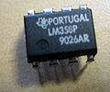

What is an Op-Amp? – The Surface
An Operational Amplifier (Op-Amp) is an integrated circuit that uses external voltage to amplify the input through a very high gain.
We recognize an Op-Amp as a mass-produced component found in countless electronics.
What an Op-Amp looks like to a lay-person
What an Op-Amp looks like to an engineer

Slide 2
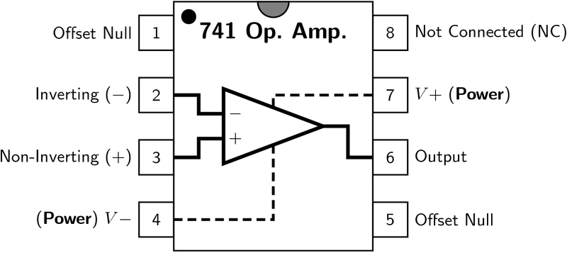
What is an Op-Amp? – The Layout
There are 8 pins in a common Op-Amp, like the 741 which is used in many instructional courses.

Slide 3
What is an Op-Amp? – The Inside
The actual count varies, but an Op-Amp contains several Transistors, Resistors, and a few Capacitors and Diodes.
For simplicity, an Op-Amp is often depicted as this:
Positive Power Supply
Inverting Input
-
Output
Non-Inverting Input
+
Negative Power Supply

Slide 4
History of the Op-Amp – The Dawn
Before the Op-Amp: Harold S. Black develops the feedback amplifier for the Western Electric Company (1920-1930)
Forward Gain
A
Input
Output
β
Feedback

Slide 5
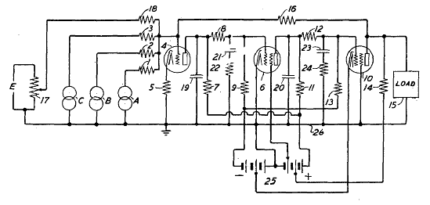
History of the Op-Amp – The Dawn
The Vacuum Tube Age
The First Op-Amp: (1930 – 1940) Designed by Karl Swartzel for the Bell Labs M9 gun director
Uses 3 vacuum tubes, only one input, and ± 350 V to attain a gain of 90 dB
Loebe Julie then develops an Op-Amp with two inputs: Inverting and Non-inverting

Slide 6
History of the Op-Amp – The Shift
The end of Vacuum Tubes was built up during the 1950’s-1960’s to the advent of solid-state electronics
The Transistor
The Integrated Circuit
The Planar Process

Slide 7

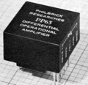
History of the Op-Amp – The Shift
1960s: beginning of the Solid State Op-Amp
Example: GAP/R P45 (1961 – 1971)
  Runs on ± 15 V, but costs $118 for 1 – 4
The GAP/R PP65 (1962) makes the Op-Amp into a circuit component as a potted module

Slide 8
History of the Op-Amp – The Evolution
The solid-state decade saw a proliferation of Op-Amps
  Model 121, High Speed FET family, etc.
Robert J. Widlar develops the μA702 Monolithic IC Op-Amp (1963) and shortly after the μA709
Fairchild Semiconductor vs. National Semiconductor
  National: The LM101 (1967) and then the LM101A (1968) (both by Widlar)
  Fairchild: The “famous” μA741 (by Dave Fullager 1968) and then the μA748 (1969)

Slide 9
Mathematics of the Op-Amp
The gain of the Op-Amp itself is calculated as:
G = V_{out}/(V₊ – V₋)
The maximum output is the power supply voltage
When used in a circuit, the gain of the circuit (as opposed to the op-amp component) is:
A_{v} = V_{out}/V_{in}

Slide 10
Op-Amp Saturation
As mentioned earlier, the maximum output value is the supply voltage, positive and negative.
The gain (G) is the slope between saturation points.
V_{out}
V_{s}⁺
V_{in}
V_{s}⁻

Slide 11
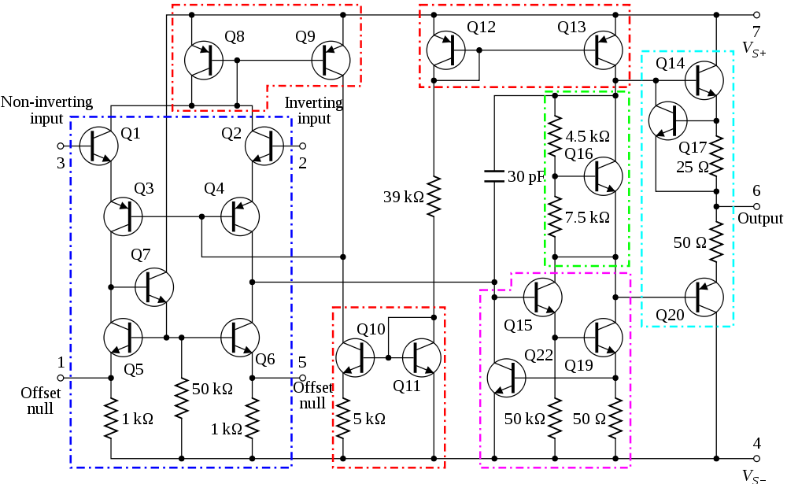
741 Op-Amp Schematic
current mirror
current mirror
voltage level shifter
output stage
differential amplifier
current mirror
high-gain amplifier

Slide 12
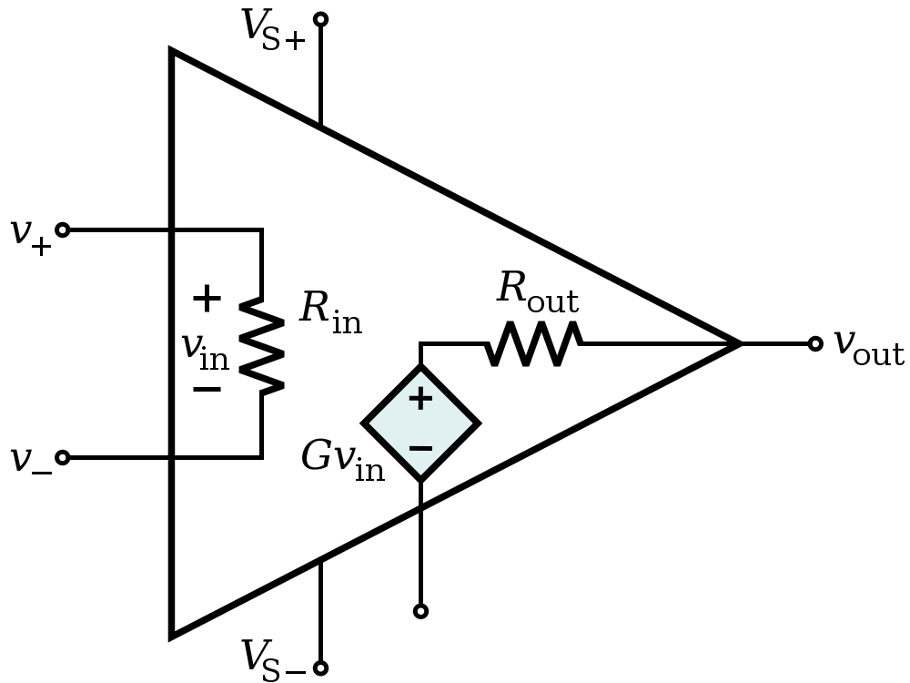
Op-Amp Characteristics
Open-loop gain G is typically over 9000
  But closed-loop gain is much smaller
R_{in} is very large (MΩ or larger)
R_{out} is small (75Ω or smaller)
  Effective output impedance in closed loop is very small

Slide 13
Ideal Op-Amp Characteristics
Open-loop gain G is infinite
R_{in} is infinite
  Zero input current
R_{out} is zero

Slide 14
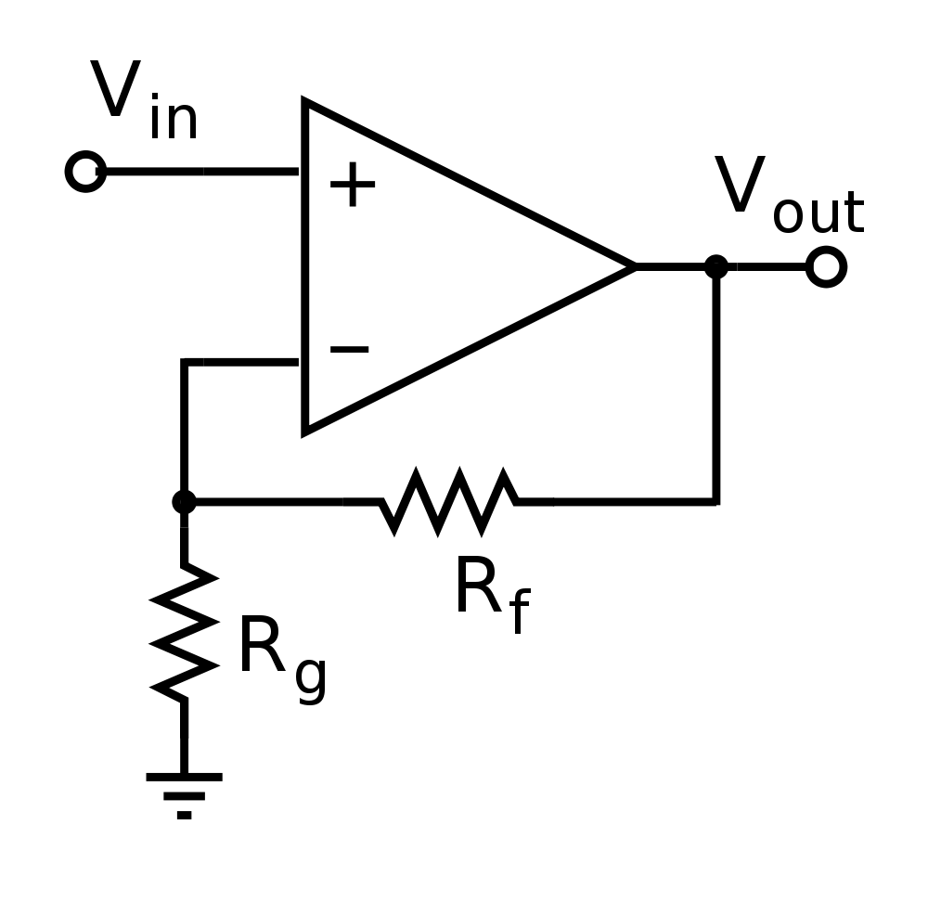
Ideal Op-Amp Analysis
To analyze an op-amp feedback circuit:
  Assume no current flows into either input terminal
  Assume no current flows out of the output terminal
  Constrain: V₊ = V₋

Slide 15
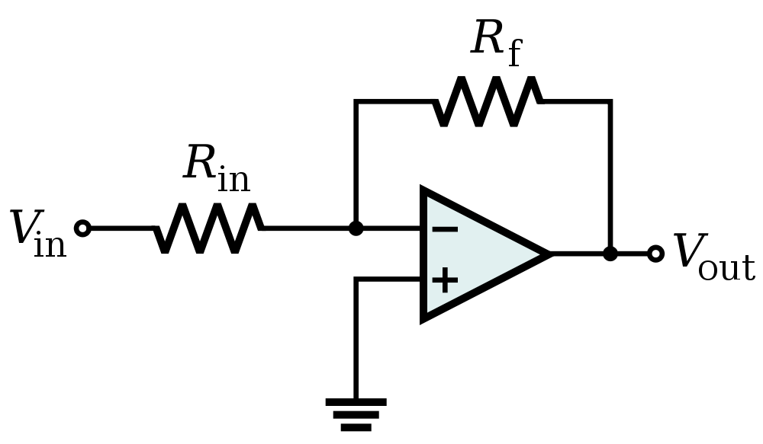

Inverting Amplifier Analysis
virtual ground

Slide 16
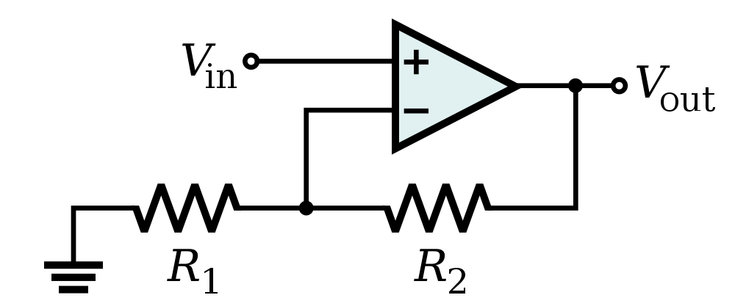

Non-Inverting Amplifier Analysis

Slide 17
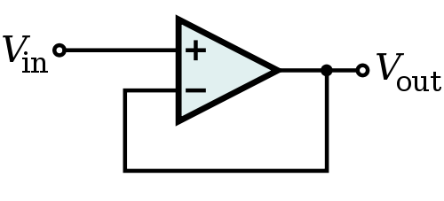
Op-Amp Buffer
Vout = Vin
Isolates loading effects
A
High output impedance
B
Low input impedance

Slide 18

Op-Amp Differentiator

Slide 19


Op-Amp Integrator

Slide 20
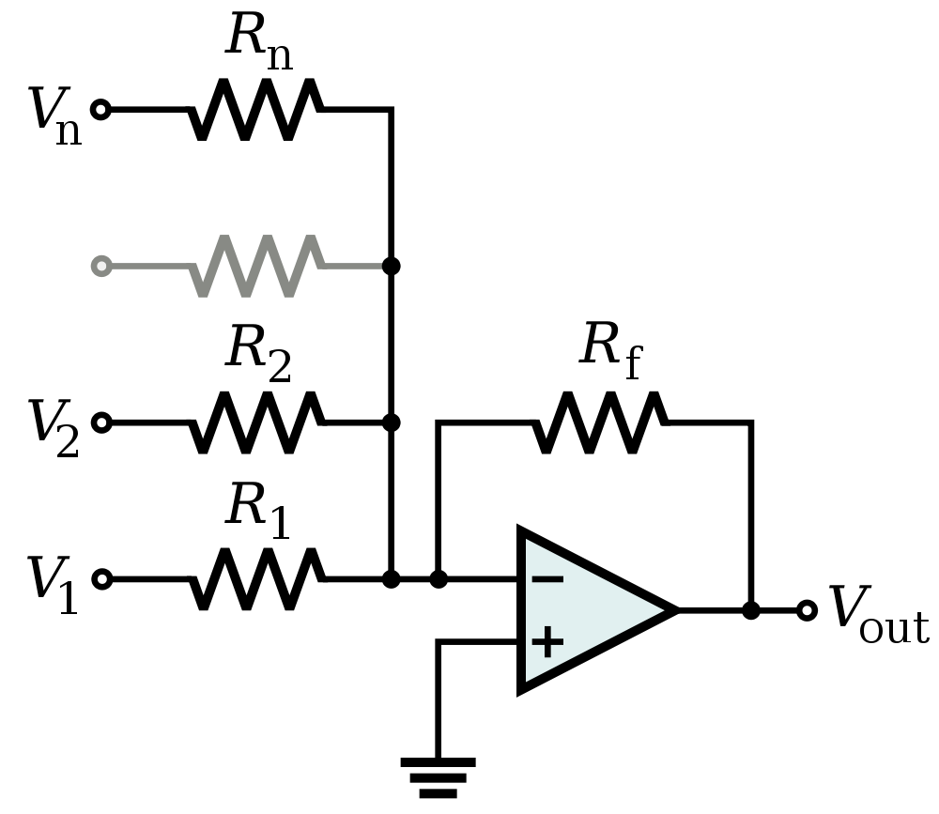

Op-Amp Summing Amplifier

Slide 21
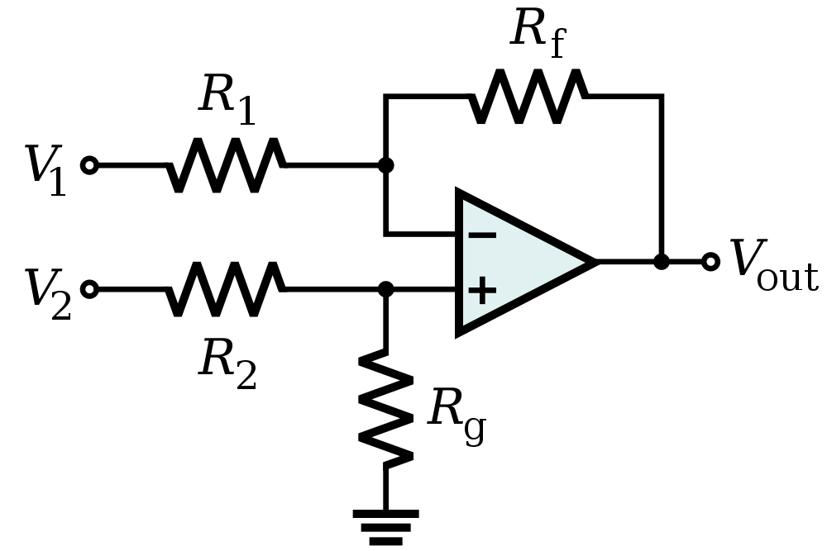


Op-Amp Differential Amplifier
If R₁ = R₂ and R_{f} = R_{g}:

Slide 22



Applications of Op-Amps
Filters
Types:
Low pass filter
High pass filter
Band pass filter
Cascading (2 or more filters connected together)
Low pass filter
C
R₂
R₁
+ V_{cc}
Low pass filter transfer function➔
-
+
+
V₀
__
- V_{cc}
+
-
Low pass filter Cutoff frequency ➔

Slide 23
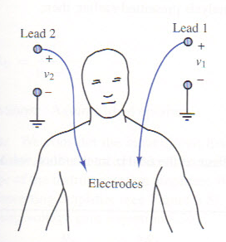
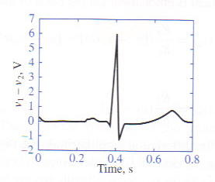
Applications of Op-Amps
Electrocardiogram (EKG) Amplification
  Need to measure difference in voltage from lead 1 and lead 2
  60 Hz interference from electrical equipment

Slide 24
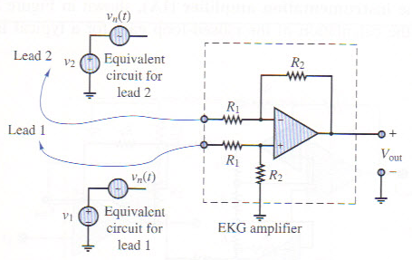
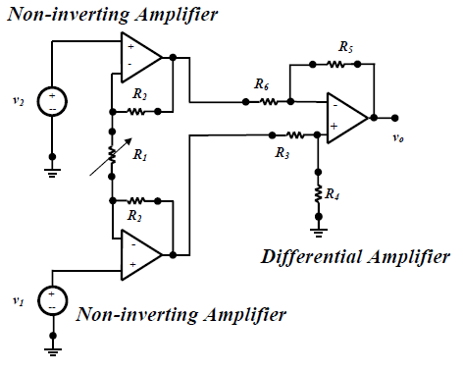
Applications of Op-Amps
Simple EKG circuit
  Uses differential amplifier to cancel common mode signal and amplify differential mode signal
Realistic EKG circuit
  Uses two non-inverting amplifiers to first amplify voltage from each lead, followed by differential amplifier
  Forms an “instrumentation amplifier”

Slide 25
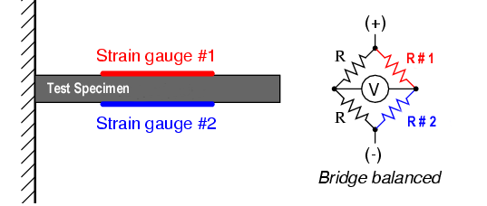
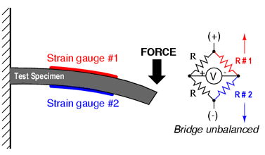
Strain Gauge
Use a Wheatstone bridge to determine the strain of an element by measuring the change in resistance of a strain gauge
(No strain) Balanced Bridge
R #1 = R #2
(Strain) Unbalanced Bridge
R #1 ≠ R #2

Slide 26
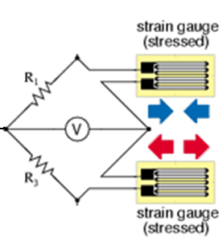
Strain Gauge
Half-Bridge Arrangement
Op amp used to amplify output from strain gauge
R + ΔR
R_{f}
R
V_{ref}
+ V_{cc}
+
-
+
+
V₀
__
-
R
- V_{cc}
R - ΔR
R_{f}
Using KCL at the inverting and non-inverting terminals of the op amp we find that ➔
ε ~ V_{o} = 2ΔR(R_{f} /R²)

Slide 27
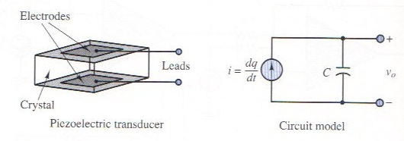
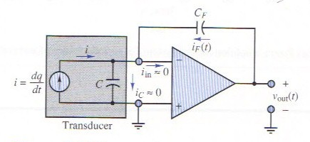
Applications of Op-Amps
Piezoelectric Transducer
  Used to measure force, pressure, acceleration
  Piezoelectric crystal generates an electric charge in response to deformation
Use Charge Amplifier
  Just an integrator op-amp circuit

Slide 28
PID Controller – System Block Diagram
P
V_{SET}
V_{ERROR}
I
Output Process
V_{OUT}
D
V_{SENSOR}
Sensor
Goal is to have V_{SET} = V_{OUT}
Remember that V_{ERROR} = V_{SET} – V_{SENSOR}
Output Process uses V_{ERROR} from the PID controller to adjust V_{out} such that it is ~V_{SET}

Slide 29
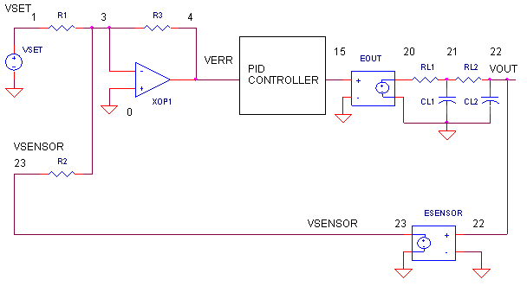
Applications
PID Controller – System Circuit Diagram
Signal conditioning allows you to introduce a time delay which could account for things like inertia
System to control
Calculates V_{ERROR} = -(V_{SET} + V_{SENSOR})
-V_{SENSOR}
Source: http://www.ecircuitcenter.com/Circuits/op_pid/op_pid.htm

Slide 30
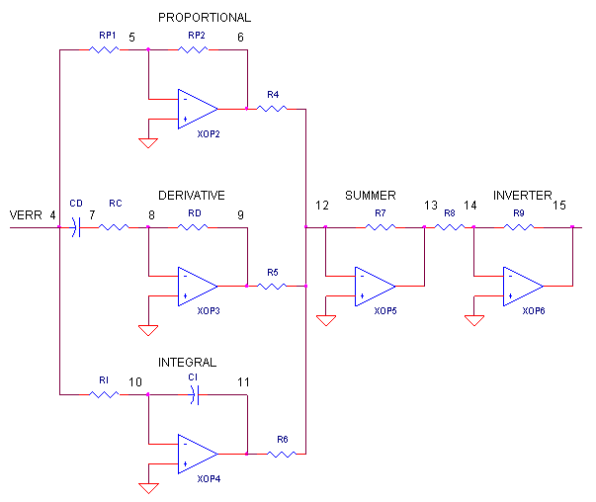
Applications
PID Controller – PID Controller Circuit Diagram
Adjust | Change
K_{p} | RP1, RP2
K_{i} | RI, CI
K_{d} | RD, CD
V_{ERR}
V_{ERR PID}

Slide 31
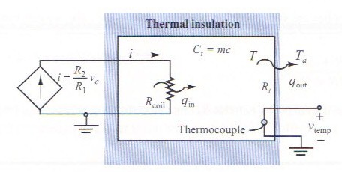
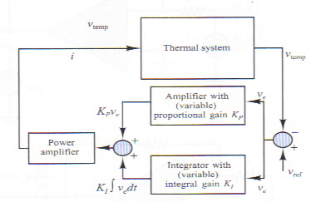
Applications of Op-Amps
Example of PI Control: Temperature Control
Thermal System we wish to automatically control the temperature of:
Block Diagram of Control System:

Slide 32
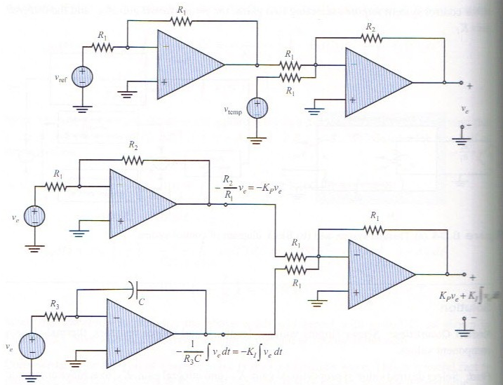
Applications of Op-Amps
Example of PI Control: Temperature Control
Voltage Error Circuit:
Proportional-Integral Control Circuit:

Slide 33
References
Cetinkunt, Sabri. Mechatronics. Hoboken, NJ: John Wiley & Sons Inc., 2007.
Jung, Walter G. Op Amp Applications Handbook. Analog Devices, Inc., 2005.
“Operational Amplifier.” http://en.wikipedia.org/wiki/Operational_amplifier.
“Operational Amplifier Applications.” http://en.wikipedia.org/wiki/Operational_amplifier_applications.

Slide 34
References
Rizzoni, G. Principles and Applications of Electrical Engineering, McGraw Hill, 2007.
http://web.njit.edu/~joelsd/electronics/Labs/ecglab.pdf

